Slide 1
DSA Study Guide
John DeVries

Slide 2
Program Structure
Usually a Console App
Look at problem statement for clues
Look for clues about required classes
Look for clues about required Methods
If Method is not specified, use them to simplify understanding of code
Use meaningful names

Slide 3
User Interface
Usually not a part of solution
Hard-coded input in Main method is usually acceptable
Look at problem statement for clues

Slide 4
How to represent data
If the problem specifies a data structure, use that structure
Look for keywords such as “given”, “return”, “ordered”, “array”, “Keep track of count” – implies Dictionary, “list”, “tree”
If no keywords:
Array is most common default choice
Use an array unless you believe another DS (e.g. Dictionary) has specific advantages
Be aware of Space Complexity
Smaller is better

Slide 5
Fundamental Operations

Slide 6
Enumerate elements
Selects each element in linear order
Selected element is determined by “index”
O(time) is N
Time complexity O(N)
Use a single loop
Use foreach for simple enumeration (all elements, one at a time, from start to end)
for (i=startValue;condition;change)
Can specify counter start value
Can specify a Boolean condition for iteration
Can specify what happens to counter for each iteration(increment, divide, other)
while
Loop only specifies condition
Everything else is up to you

Slide 7
Swap elements
Swaps position of elements in a linear DS
Part of many (most?) solutions
element1
element2
temp = element1
element1 = element2
element2 = temp

Slide 8
Reverse all elements
Swaps position of elements equally distant from center of array
E.g. Reverse DS, Finding Palindromes,
Time complexity O(N)
For an array of N elements
firstElement = i
LastElement = N-1
Enumerate N/2 elements
For each cycle, Swap element[i] with element[N-1-i]
temp = element[i]
elementi = element[N-1-i]
Element[N-1-i] = temp

Slide 9
Array
N = array.length
One chunk of memory – items are contiguous
[0] | [1] | [2] | [3] | … |  |  |  | N-1-I | N-1
Val1 | Val2 | Val3 | val4 |  |  |  |  |  | ValLast
Contiguous in memory
High performance compared to more advanced collections (e.g. List, Dictionary)
Statically allocated – fixed size
Zero-based indexes
Strongly typed
Values may be any data type, including custom types defined by a Class

Slide 10
Reverse Entire Array
a
m
a
z
o
n
0
1
2
3
4
5
8
7
6
5
4
3
Temp =
1
“Length” is number of elements in array
Loop will repeat Length/2 times

Slide 11
Compare all values in array
Choose a value
Compare to all other values, one at a time
Choose the next value and repeat step 2
Used in sorting
Time complexity O(N2)
Enumerate array
For each selected value, enumerate all other elements
Do comparison at each step
Use nested loops
for(i=0; i <= N-1; i++)
For(j=i+1; j <= N-1; j++)

Slide 12
Find Minimum or Maximum Value
Outside of loop, initialize a variable to hold min or max value
Enumerate all values
In Loop, compare each selected value with min or max. If smaller than min or greater than max, assign to min or max
Used in sorting
Time complexity O(N2)
Enumerate array

Slide 13
Compare all elements of array
i
j
a
m
a
z
o
n
0
1
2
3
4
5
Outer Loop: for(i=0; i<=N-1; i++)
Inner Loop: for(j=0; j<=N-1; j++)

Slide 14
Find index that meets a condition
Define pointer (separate from index of loop)
Use “if” inside loop to set index of pointer

Slide 15
Reverse Even Index elements
1
2
3
4
5
6
7
0
1
2
3
4
5
6
7
2
5
4
3
6
1
Temp =
“Length” is number of elements in array
Loop will repeat Length/2 times

Slide 16
Compare values at specified indexes
Example: Reverse only vowels in a string
Find indexes of first and last vowels
Swap the elements at those indexes
Iterate

Slide 17

Reverse Vowels Only
i
j = n-1-i
a
m
a
z
o
n
0
1
2
3
4
5
o
m
a
z
a
n
Temp =
a
n is number of elements in array
Loop will repeat n/2 times

Slide 18
Reverse vowels
static bool isVowel(char c)
{
return (c == 'a' || c == 'A' || c == 'e'
|| c == 'E' || c == 'i' || c == 'I'
|| c == 'o' || c == 'O' || c == 'u'
|| c == 'U');
}
// Function to reverse order of vowels
static String reverseVowel(String str)
{
// Start two indexes from two corners
// and move toward each other
int i = 0;
int j = str.Length-1;
char[] str1 = str.ToCharArray();
while (i < j)
{
if (!isVowel(str1[i]))
{
i++;
continue;
}
if (!isVowel(str1[j]))
{
j--;
continue;
}
// swapping
char t = str1[i];
str1[i]= str1[j];
str1[j]= t;
i++;
j--;
}
String str2 = String.Join("",str1);
return str2;

Slide 19
Keeping a Tally
Keep a count of each of several different types of items
E.g. count letter occurrences to check for anagrams, Find missing number,
Create a dictionary with item being tallied as Key
If new key item, add with Value = 1
If key already in dictionary, increment the Value

Slide 20
Partition array
Break up array into smaller sub-arrays
Apply this iteratively or recursively until the sub-arrays cannot be made smaller
Often part of Sort method
Basis of Divide and Conquer
Instead of incrementing a counter in loop, divide a partition length

Slide 21
Search
Find an element that meets a specified condition
Brute force – enumerate all elements and test condition (linear search)
All better search solutions involve pre-processing, usually sorting
Searching Algorithms – GeeksforGeeks
Linear search – Enumerate and Compare
Binary search – Partition iteratively

Slide 22
Sort
Order elements based on some property (Key)
Selection sort – Compares all elements to move each one to correct position

Slide 23
Compare – the base operation for all searches and sorts
All searches and sorts require that you be able to compare two elements and return the relative order
All data in a computer is binary (0’s and 1’s) register1 0101100100011100011000011 register2 0101100100011100011000011 AND 1111111111111111111111111

Slide 24
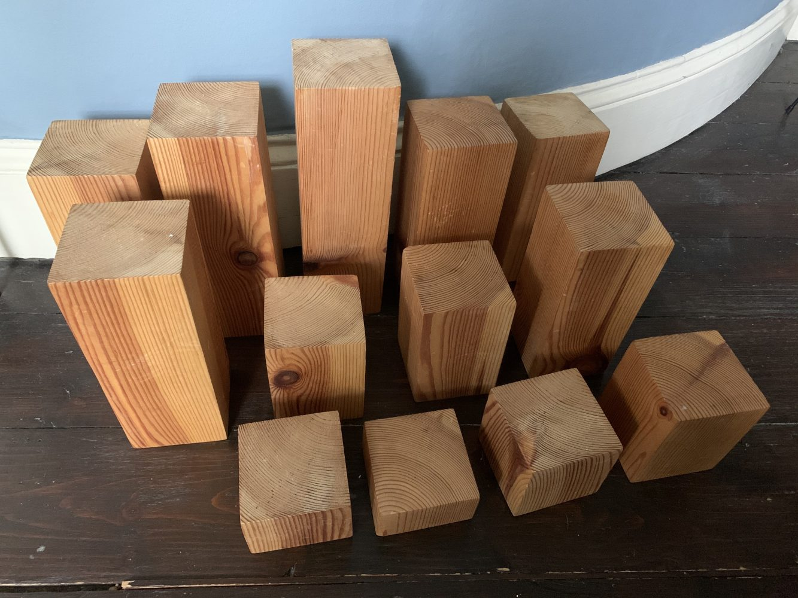

Slide 25
Binary Tree Node
Basic element of Binary Tree
Needs to be included in solutions to Binary Tree problems
class Node {
public <T> data;
public Node left;
public Node right;
public Node(<T> item)
{
data = item;
left = null;
right = null;
}
}

Slide 26
Working with an external service
External Service
(File or DB or Network or …)
In-Memory Proxy for External Service
(Client or Context Object)
Your Code

Slide 27
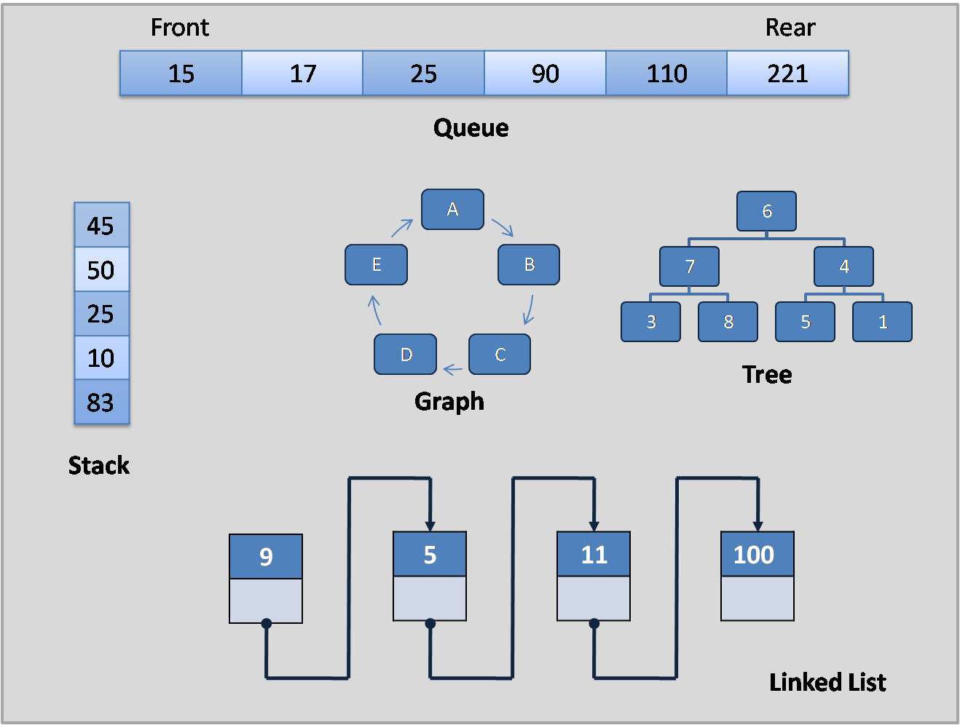
Common Data Structures

Slide 28
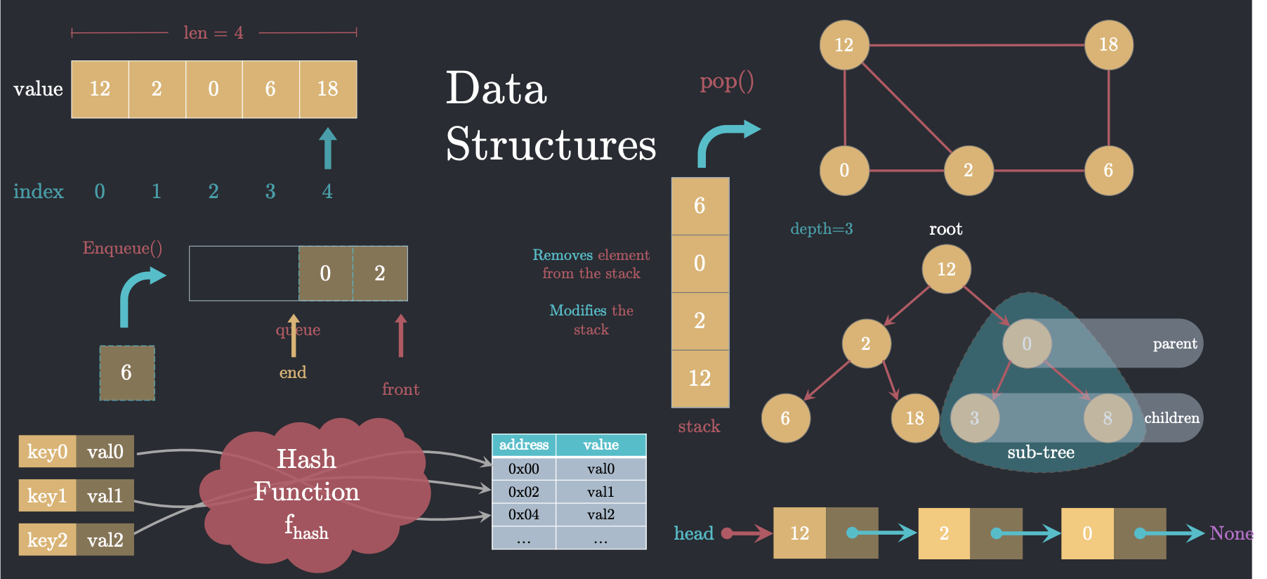
Common Data Structures

Slide 29
Normal Function
State
void MyFunction()
{}
State
MyFunction
Restores
State from
Stack
Stack

Slide 30
Recursive Function
State
void MyFunction()
{}
State Function 2
State Function 1
State Main
MyFunction 1
MyFunction 2
MyFunction 3
Stack

Slide 31
Lower Plot Problem – LeetCode 605
Array flowerPlots Length = l
i-1
i
i+1
1 | 0 | 0 | 1 | 0 | 0 | 0 | 1
Flowers cannot be in adjacent plots
For number n, can you plant n new flowers?

Slide 32
Stack
[…]
[5]
[4]
Value4
Everything going on at this point in thread of execution
[3]
Value3
Everything going on at this point in thread of execution
push
pop
[2]
Top =1
Value2
Everything going on at this point in thread of execution
[1]
Value1
Everything going on at this point in thread of execution
[0]
array

Slide 33
Dictionary
[…]
[5]
[4]
[3]
Key3
LastName + FirstName
User3
Info about this user
[2]
Key2
LastName + FirstName
User2
Info about this user
[1]
Key1
LastName + FirstName
User1
Info about this user
[0]
key
value
dictionary

Slide 34
Implementing a Method
Context
Everything going on at this point in thread of execution
Thread
Thread
Context
Everything going on at this point in thread of execution
Thread
Method
Context
Everything going on at this point in thread of execution
Stack

Slide 35
Implementing a Recursive Method
Context
Everything going on at this point in thread of execution
Thread
Thread
Method R1
Context R3
Everything going on at this point in thread of execution
Thread
Context R2
Everything going on at this point in thread of execution
Method R2
Context R1
Everything going on at this point in thread of execution
Context
Everything going on at this point in thread of execution
Method R3
Context R4
Everything going on at this point in thread of execution
Method R4
Stack

Slide 36
Understanding a complex conditional
For each element of the condition, create a separate variable that stores the Boolean result
Give the variable a name that reminds you what the Boolean represents
Replace the element with the new variable in the complex condition
If (i==0 && i-1 ….
bool isFirstPlot = (i== 0)
If (isFirstPlot && …

Slide 37
Class LinkedList
new LinkedList
new Node (head)
Data<T>
Next ==
Class Node
T Data
Node Next
new Node(Next)
Data<T>
Next == null

Slide 38
count = 0
For (i=0;
If (array[i] != 0
array[count++] = array[i]
i
[2,4,0,3,0,5]
count

Slide 39
Queue
end
start
0 | 1 | 2 | 3 | 4 | 5
Message1
message3
message4
message2

Slide 40
IncomingCall call = new IncomingCall();
var call = new IncomingCall();
IncomingCall call = new();

Slide 41
Rotate Matrix
90°
0,0 | 0,1 | 0,2
1,0 | 1,1 | 1,2
2,0 | 2,1 | 2,2
0,0 | 0,1 | 0,2
1,0 | 1,1 | 1,2
2,0 | 2,1 | 2,2
2,0
1,0
0,0
2,1
1,1
0,1
2,2
1,2
0,2
Index i,j

Slide 42
Rotate Matrix
90°
0,0 |  |  | 0,3
 |  |  | 3,3
 |  |  | 0,3
3,0 |  |  | 3,3
0,0 | 0,1 | 0,2
1,0 | 1,1 | 1,2
2,0 | 2,1 | 2,2
0,0 | 0,1 | 0,2
1,0 | 1,1 | 1,2
2,0 | 2,1 | 2,2
2,0
1,0
0,0
2,1
1,1
0,1
2,2
1,2
0,2
Index i,j

Slide 43
Product Except Self – LeetCode 238
Prefix
Suffix
1 | 2 | 3 | 4
index
0 | 1 | 2 | 3

Slide 44
Product Except Self – LeetCode 238
Prefix
Suffix
1 | 2 | 3 | 4
index
0 | 1 | 2 | 3
nums
int rightSide = 1;
for (int i = nums.Length - 1; i >= 0; i--)
{
result[i] = result[i] * rightSide;
rightSide *= nums[i];
}
result[0] = 1;
for (int i = 1; i < nums.Length; i++)
result[i] = result[i - 1] * nums[i - 1];
1
index
0 | 1 | 2 | 3
result

Slide 45
Collections
Used to hold groups of data items of the same type
List
Dictionary
Value
Key
Value
3
Monday
3
5
Tuesday
5

Slide 46
Insertion Sort Sort
25
3
56
12
47
8
0
1
2
3
4
5
Temp =
“Length” is number of elements in array
Loop will repeat Length/2 times

Slide 47
Shell Sort
25
3
56
12
47
8
0
1
2
3
4
5
Temp =
“Length” is number of elements in array
Loop will repeat Length/2 times

